Slide 1
Denoising auto-encoders
denoising auto-encoder
& denoising deconvolutional auto-encoder

Slide 2

Unsupervised learning
Holy grail of Machine Learning!

Slide 3
Encoder?

Slide 4
Auto-Encoder?
Output
Decoding
Encoding
Input

Slide 5
Auto-Encoder?
Encoder + Decoder Structure

Slide 6
Denoising Auto-Encoder?
Input and output data of the auto-encoder is basically identical.
Then, how can we make this network to have denoising power?

Slide 7

Denoising Auto-Encoder?
Just add noise to the input layer while training!

Slide 8
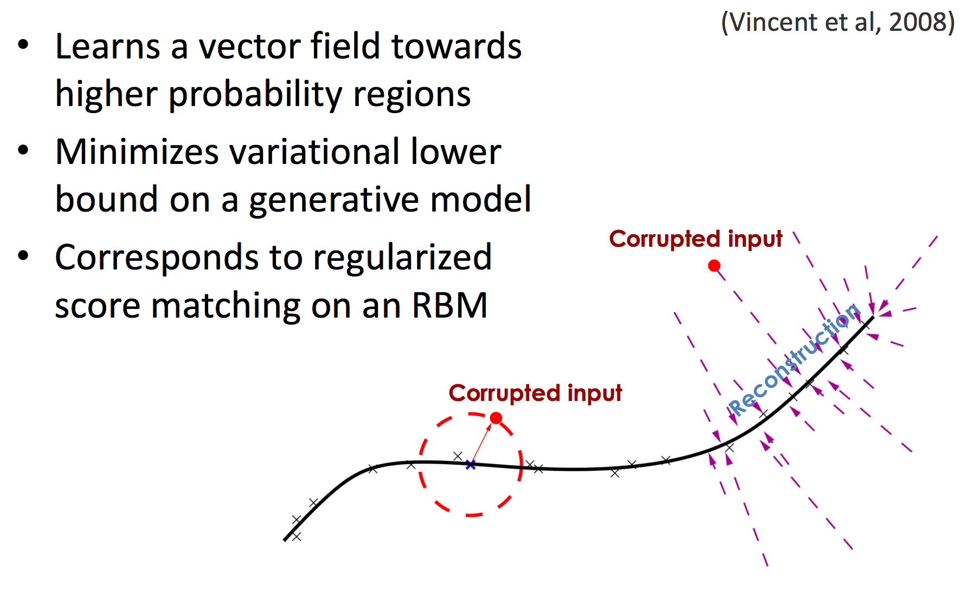
Denoising Auto-Encoder?

Slide 9

Super simple, but

Slide 10
dae_mnist_dropout

Slide 11
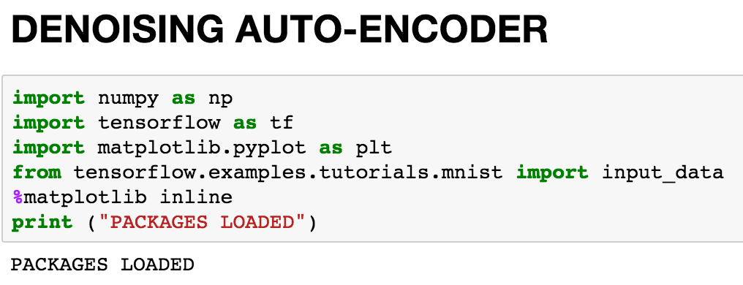

Slide 12
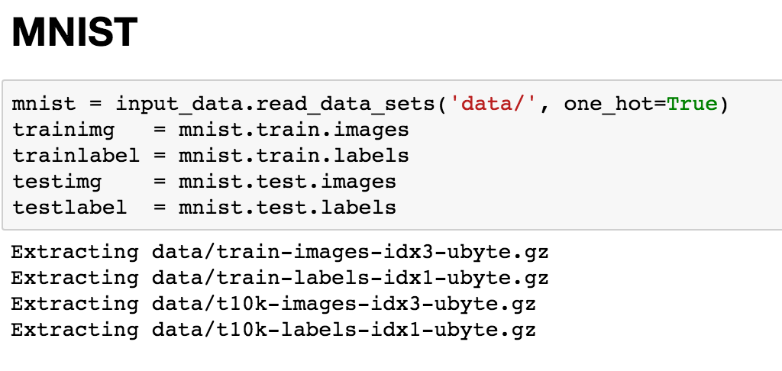

Slide 13
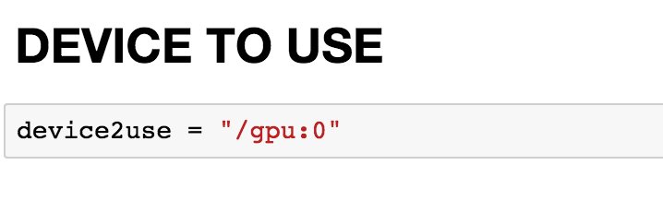

Slide 14
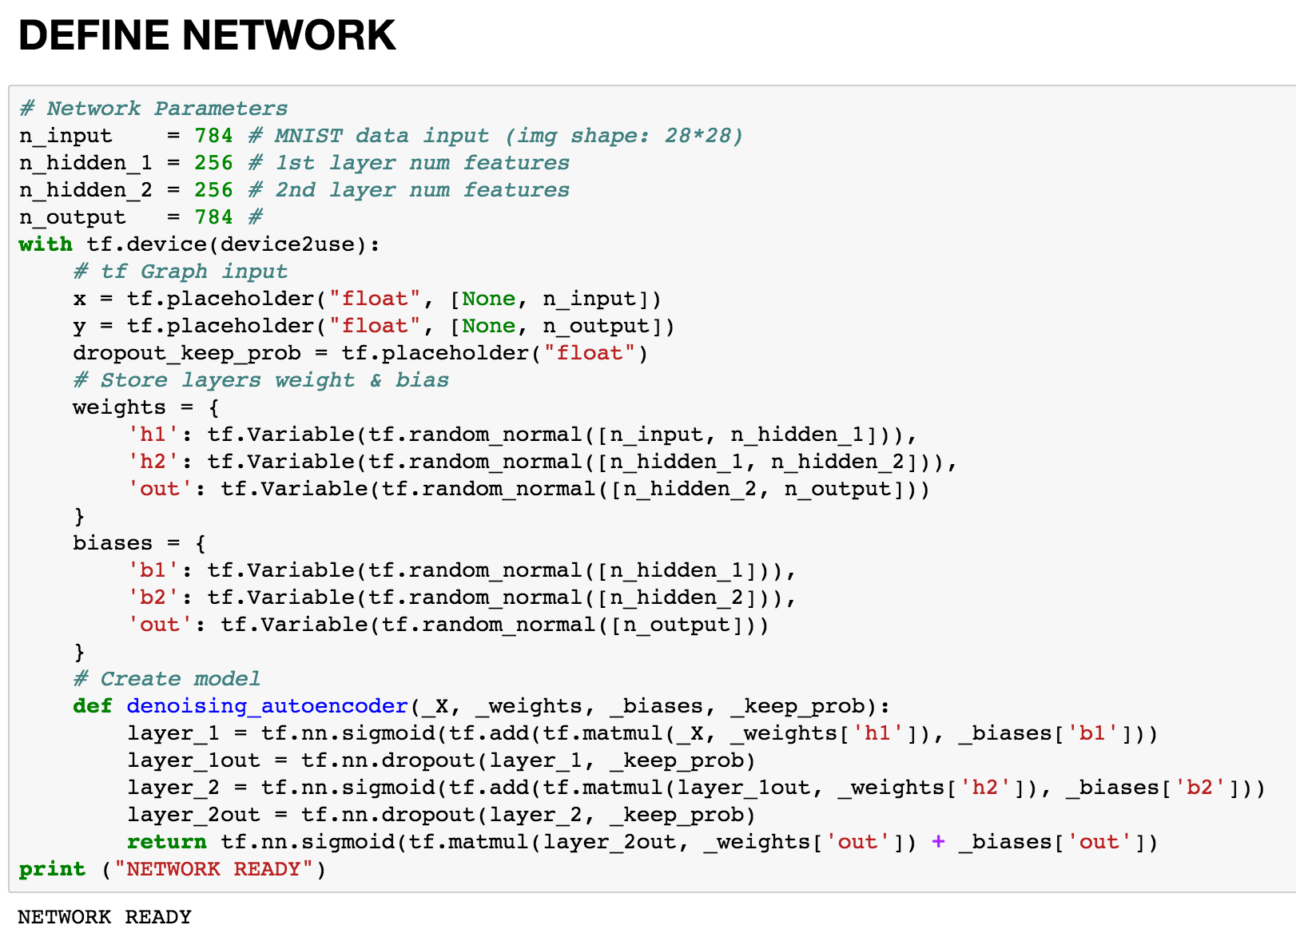

Slide 15
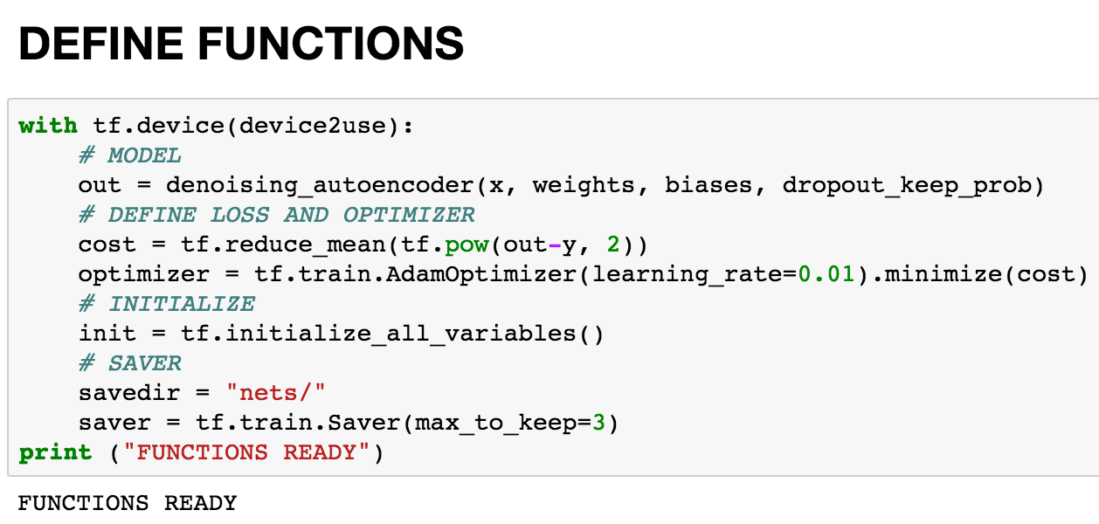

Slide 16
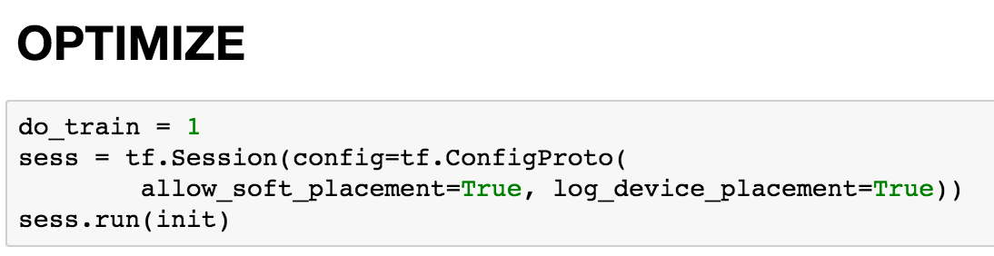

Slide 17
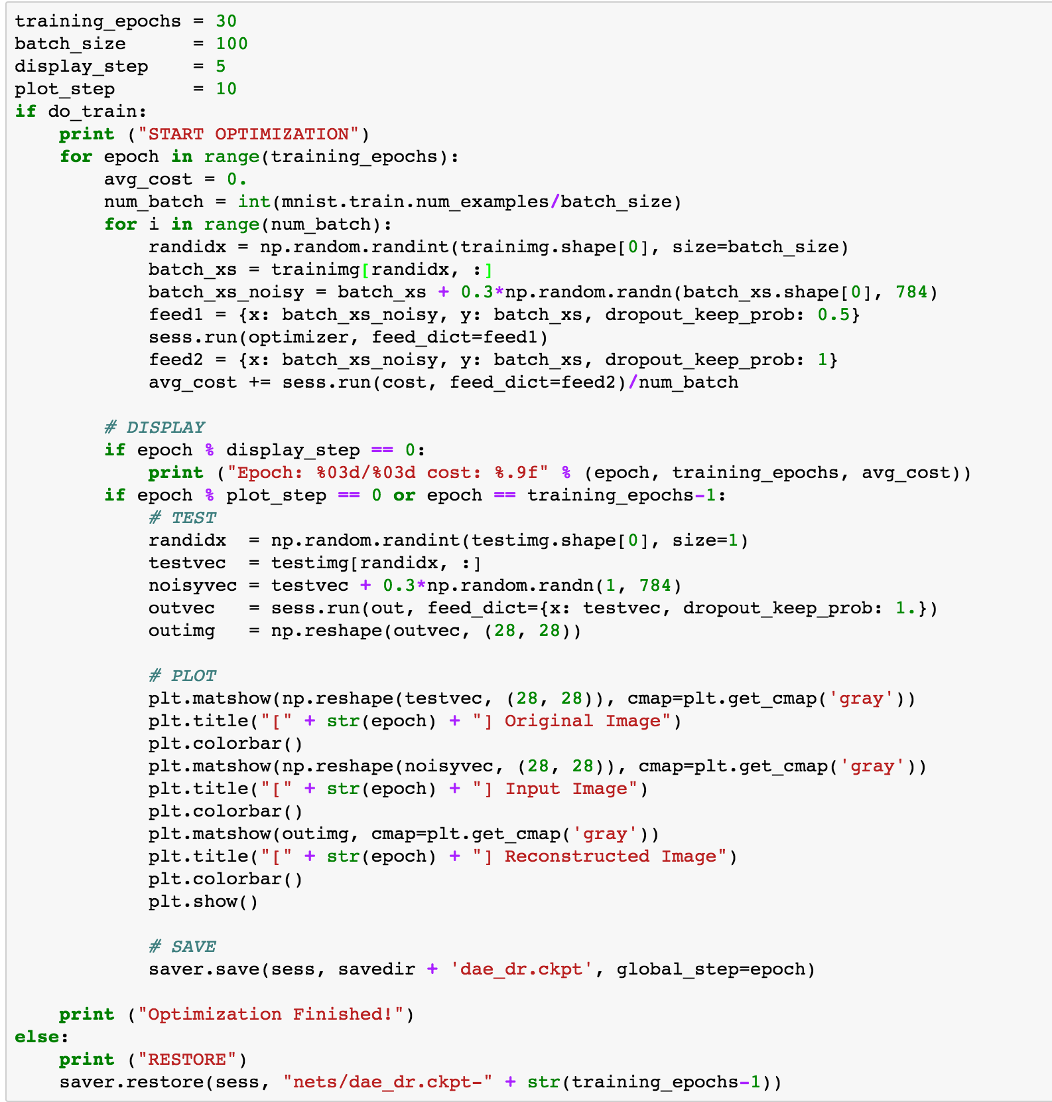

Slide 18
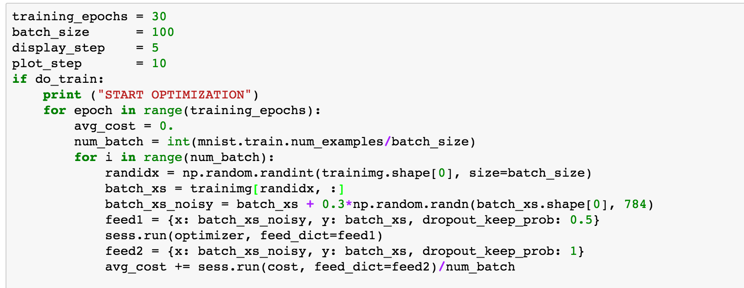

Slide 19
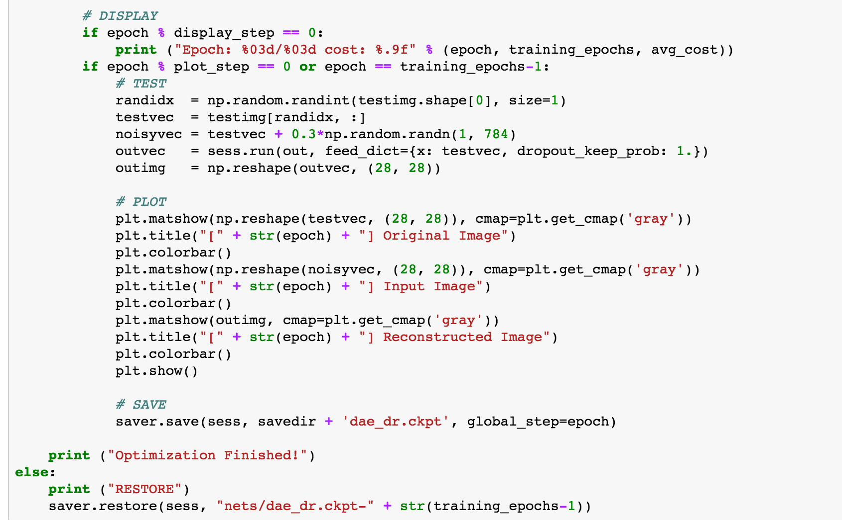

Slide 20
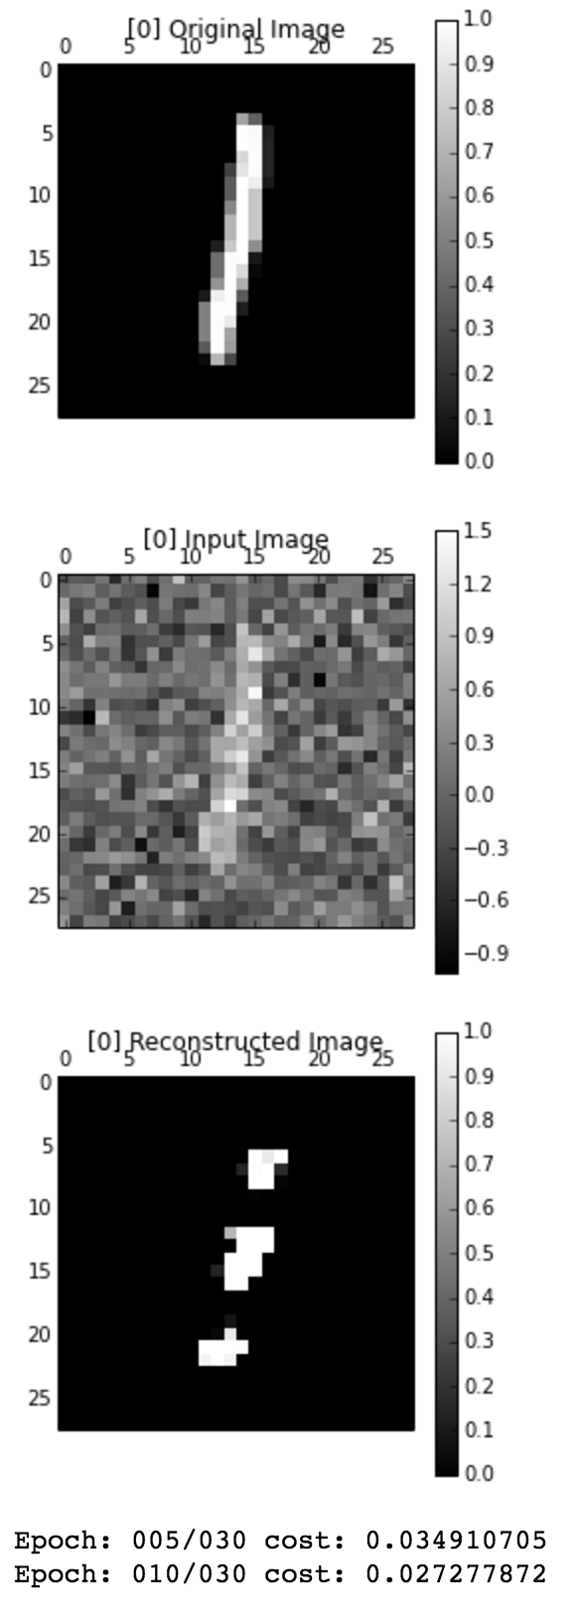
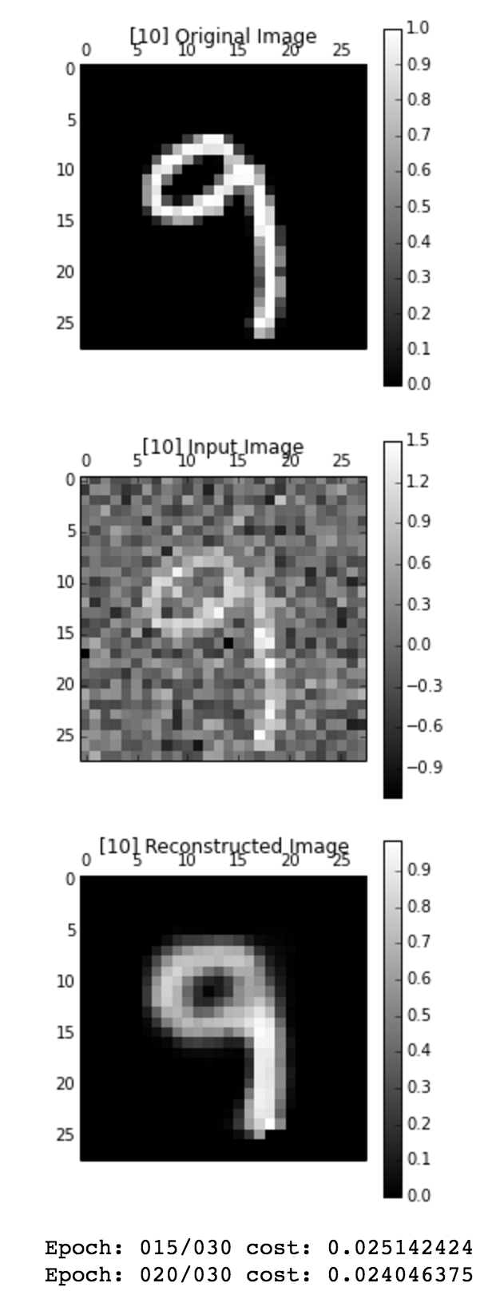
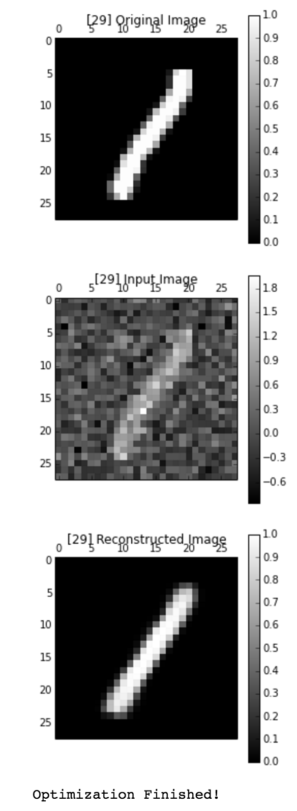

Slide 21
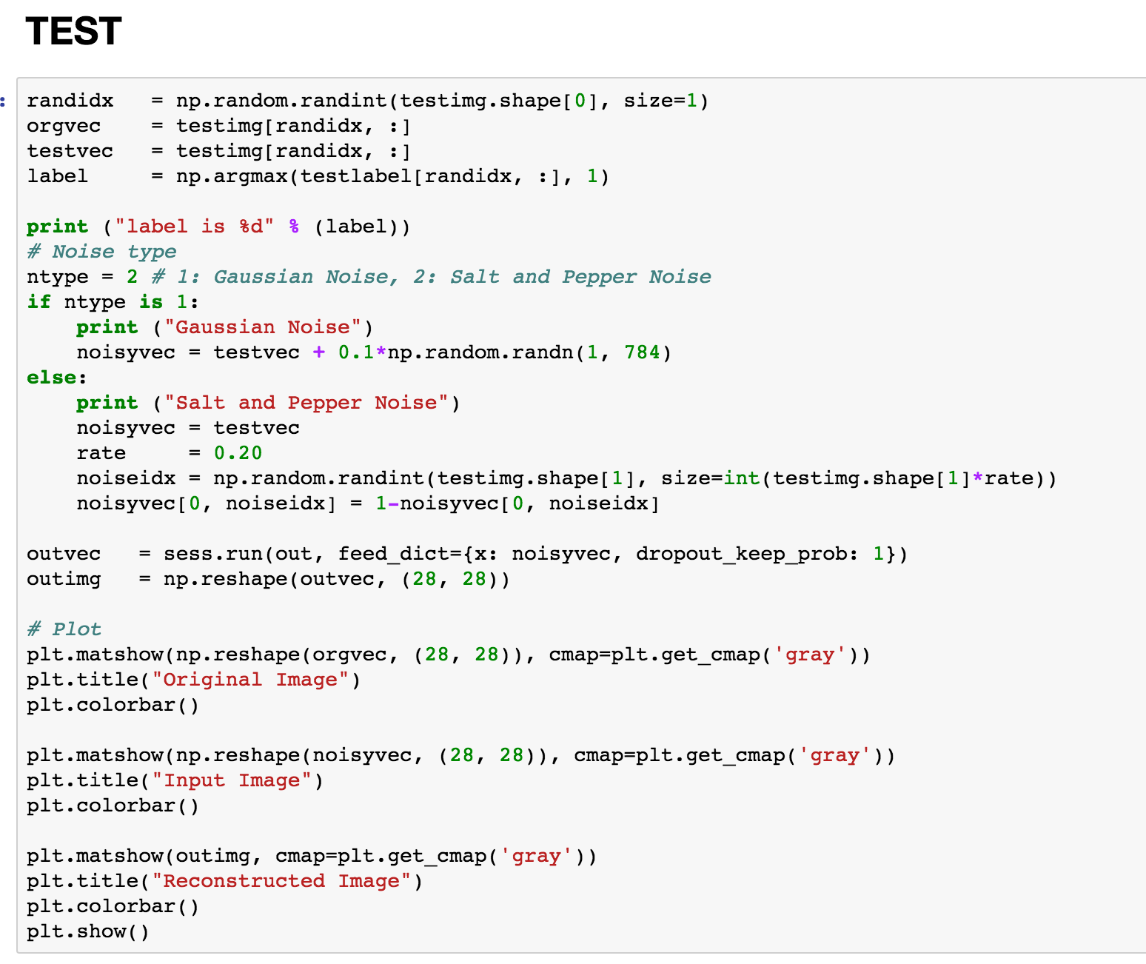

Slide 22
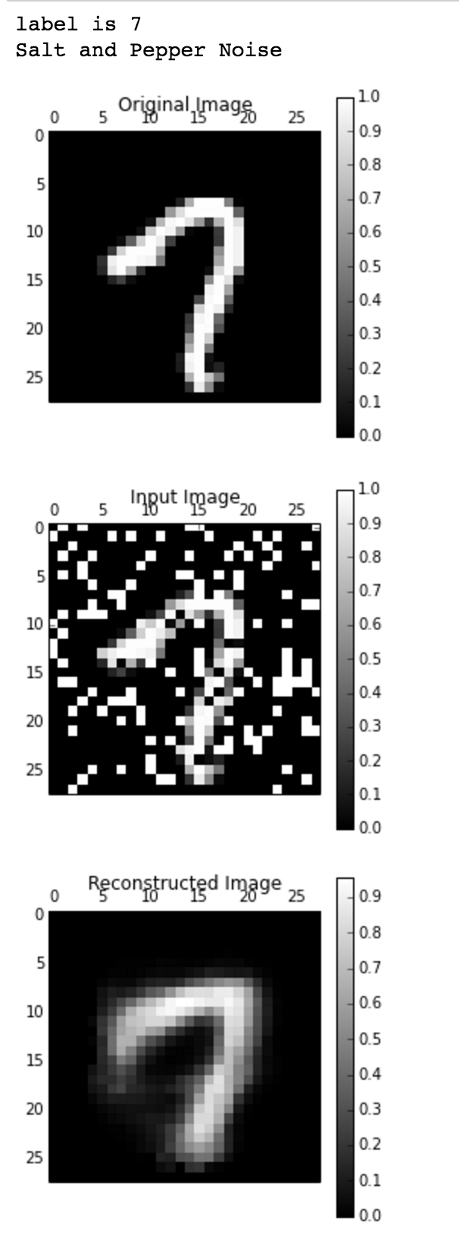

Slide 23
Denoising convolutional auto-encoder

Slide 24

Deconvolutional operator?
Conv
Deconv

Slide 25
cae_mnist

Slide 26
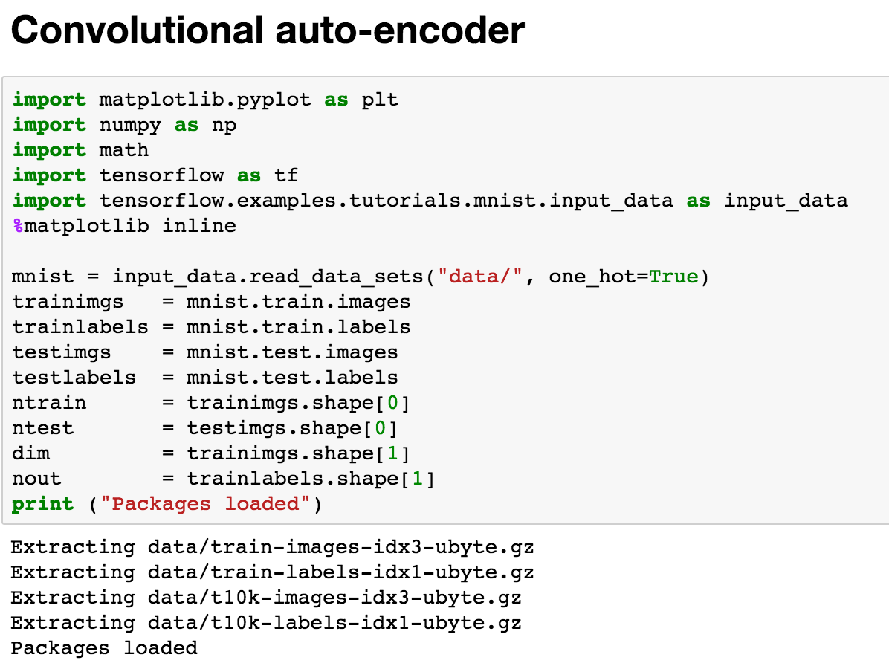

Slide 27
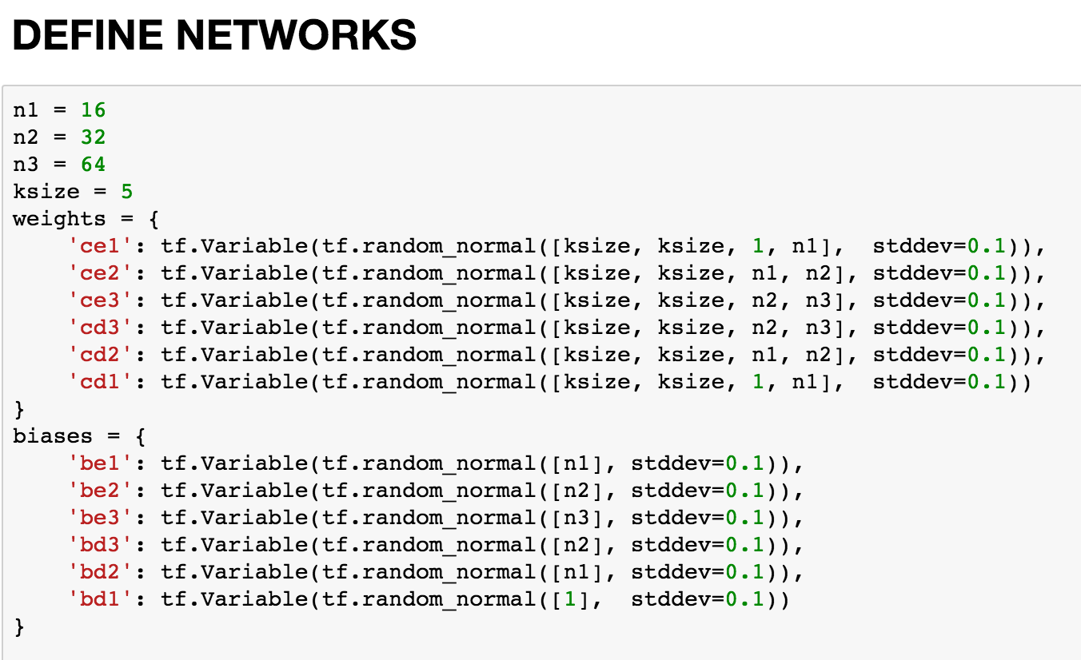

Slide 28
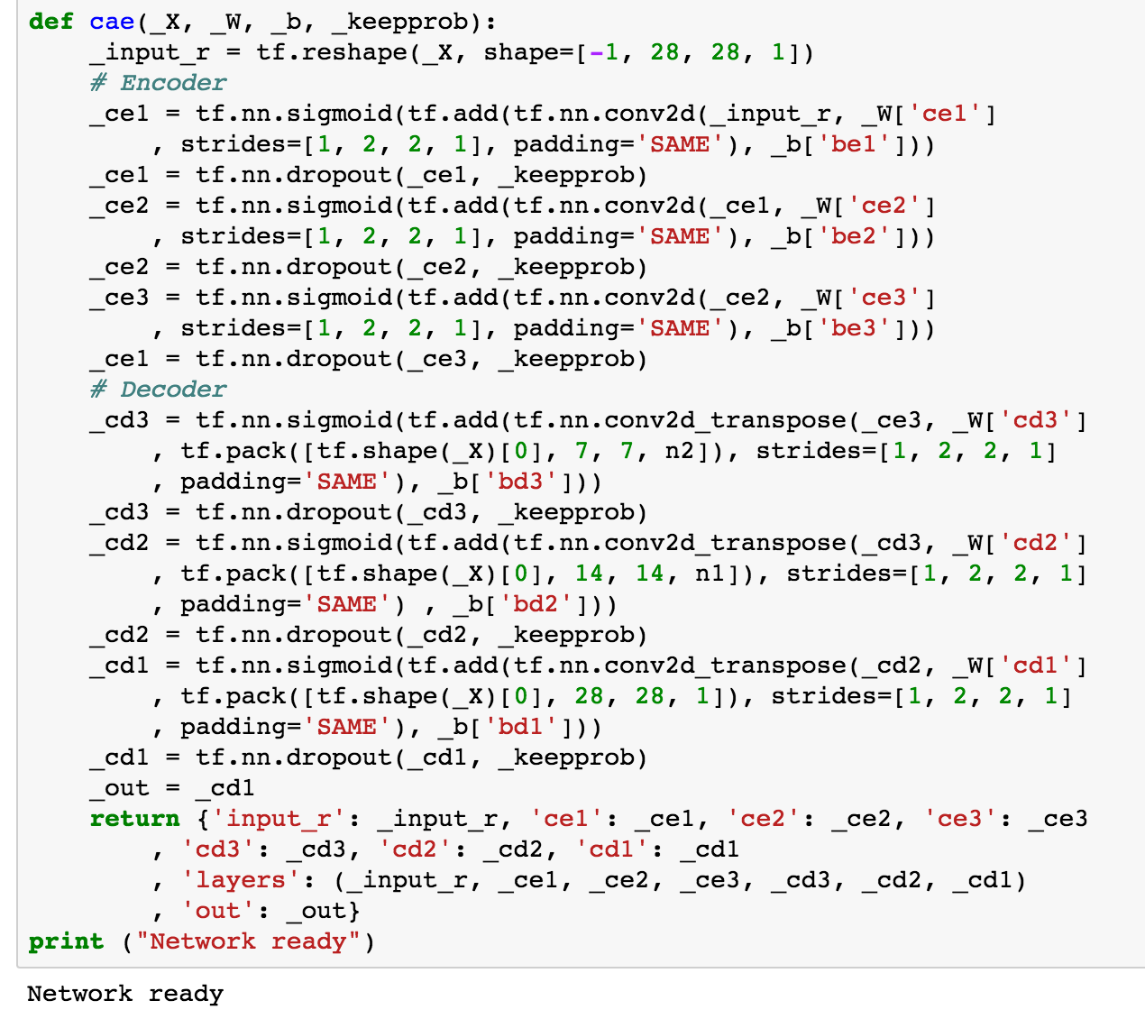

Slide 29
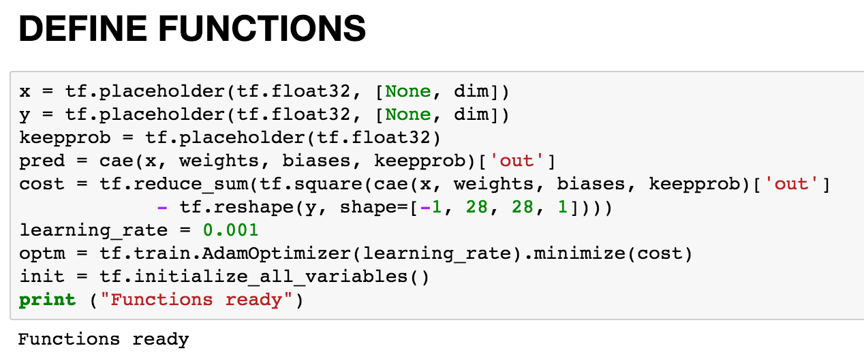

Slide 30
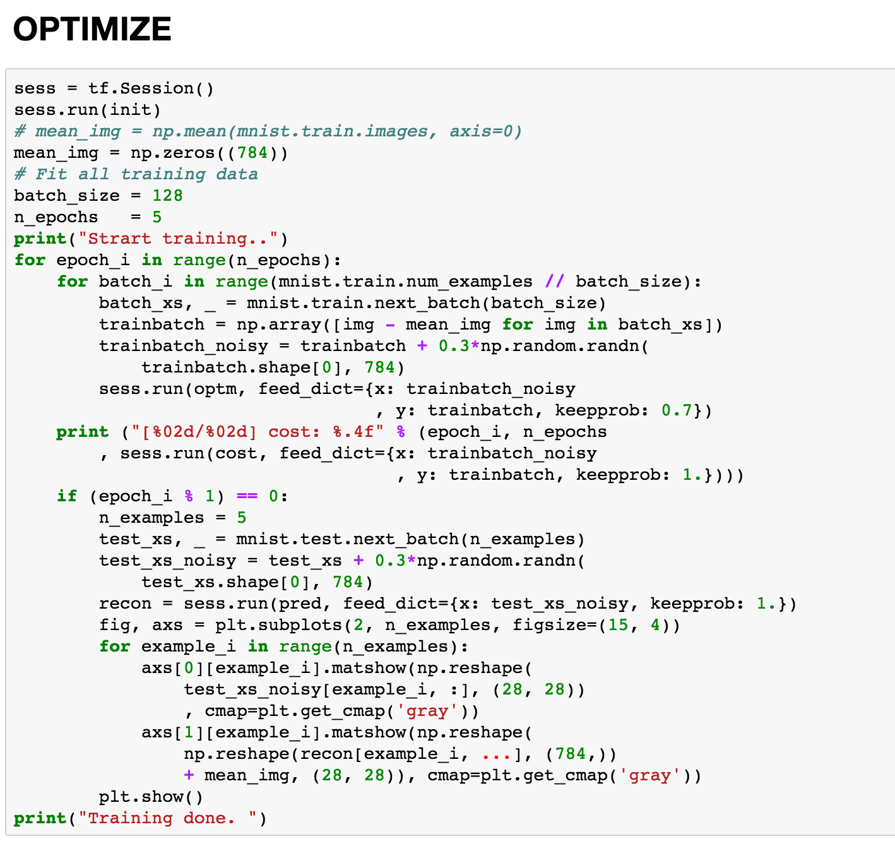

Slide 31
Epoch: 1

Slide 32
Epoch : 2

Slide 33
Epoch : 3

Slide 34
Epoch : 4

Slide 35
Epoch : 5

Slide 36
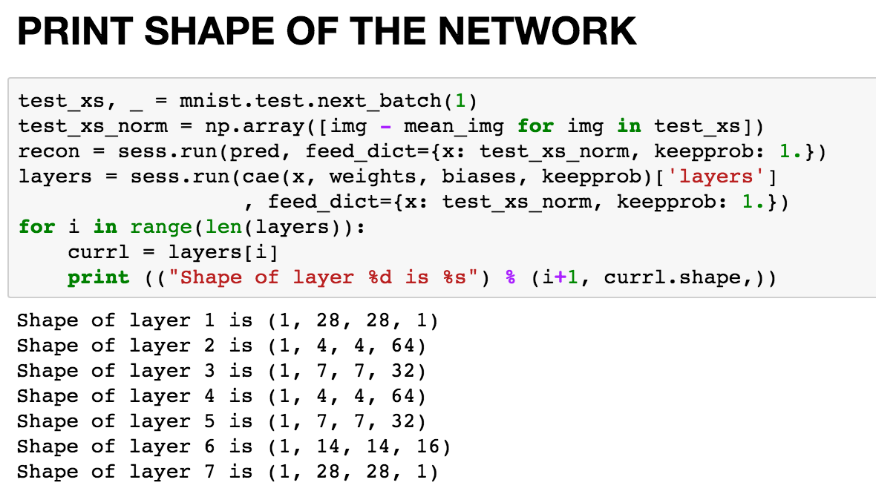

Slide 37
